Slide 1
Thank you Veterans of the Concordia R-2 students and staff.

Slide 2
Dave Adams
Rank: Master Sergeant
Years of Service: 26
Deployments: Desert Storm 3 times, Kuwait twice, and Saudi Arabia
Related to CES students Maddison and Kaylee Hall

Slide 3
Roger Anderson
Rank: E-5
Years of Service: 4
Deployments: Vietnam (1970-1971)
Military Service: Served in Vietnam
Related to Jayden (CES student)

Slide 4
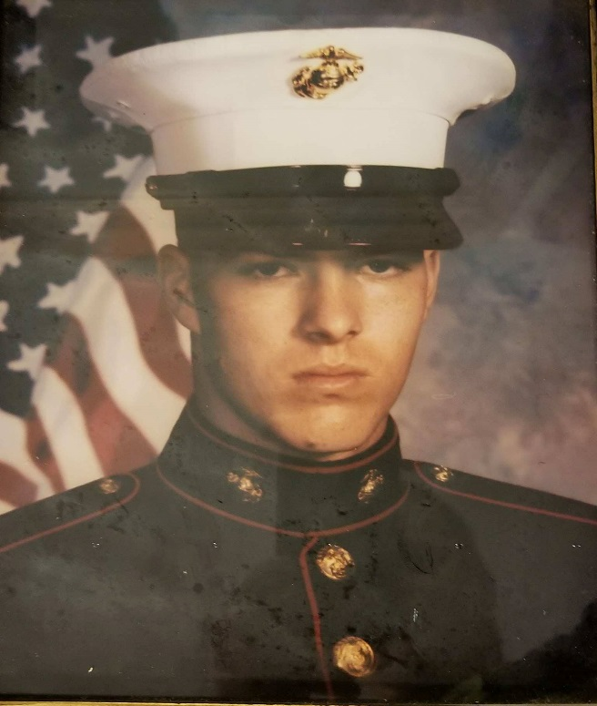
William Boles
Rank: 2311 (ammunition technician)
Years of Service: 5
Deployments: William was decorated with a meritorious unit commendation, and a second award expert on the rifle range. William was in the Marine Corps and was stationed at Camp Lejeune 2nd Supply battalion 2nd forward service support group
Related to CES student Kollen Akau

Slide 5
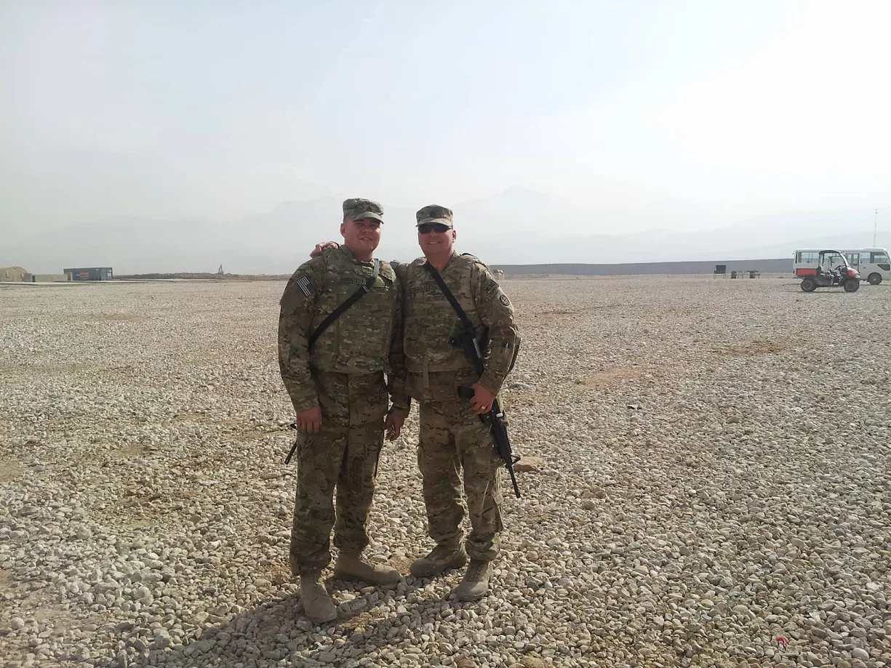
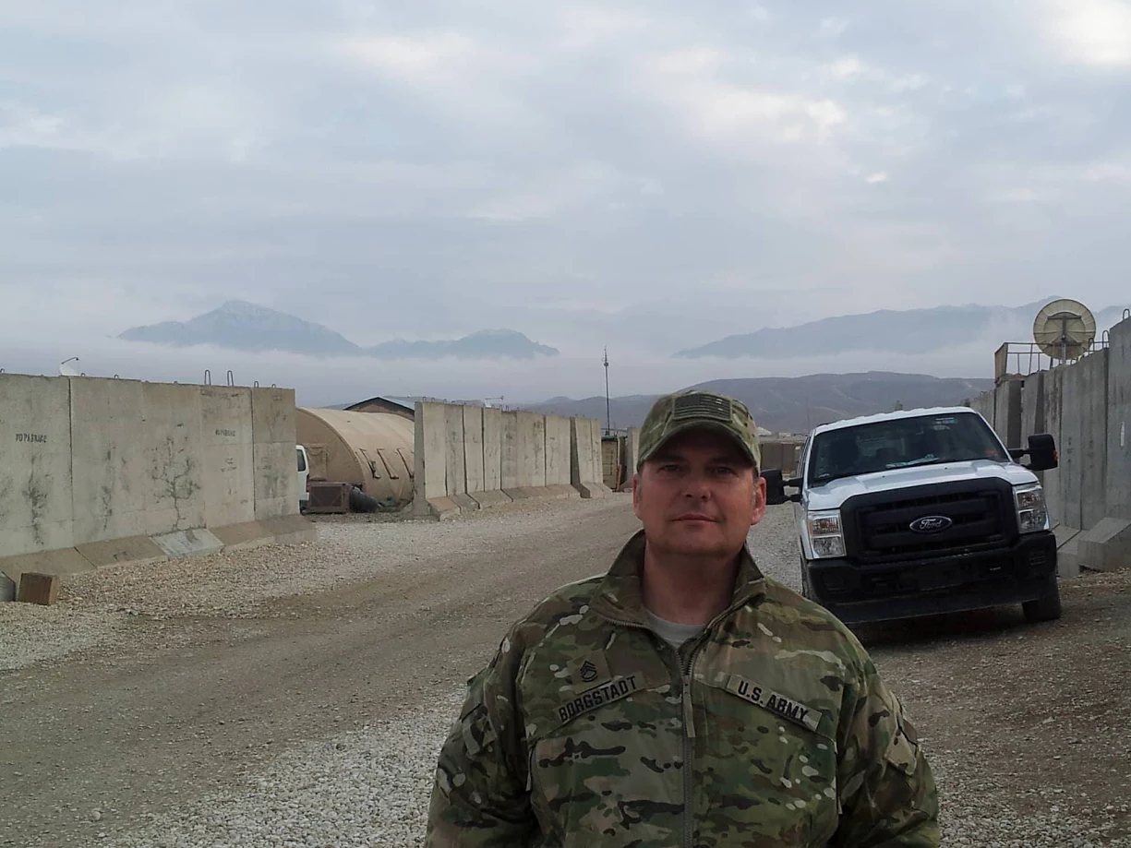
August Ed Borgstadt
Rank: E8 Master sergeant
Deployments: Germany 2001, Iraq 2004, Afghanistan 2013.
Military service: Marine Corps 1984-1989, Active
Duty National Guardsmen 1989-present. Positions held
are crew chief on A-4M, OH-58, AH-1, UG-1, AH-64,
UH-60 aircrafts, Platoon Sergeant, Current Operation
NCOIC for Blackhawk Helicopter Battalion. Awards are
Bronze Star, Air Medal, 9 Army Commendations
Medals, 4 Army Achievement Medals, Combat Action
Badge, and numerous lesser awards.
Grandpa to Hallie Borgstadt (CHS)

Slide 6
James Borgstadt
Rank: Sergeant
Years of Service: 15
Deployments: Desert Storm, Germany, Honduras, Kuwait
Related to CES students Kaylee and Madison Hall

Slide 7
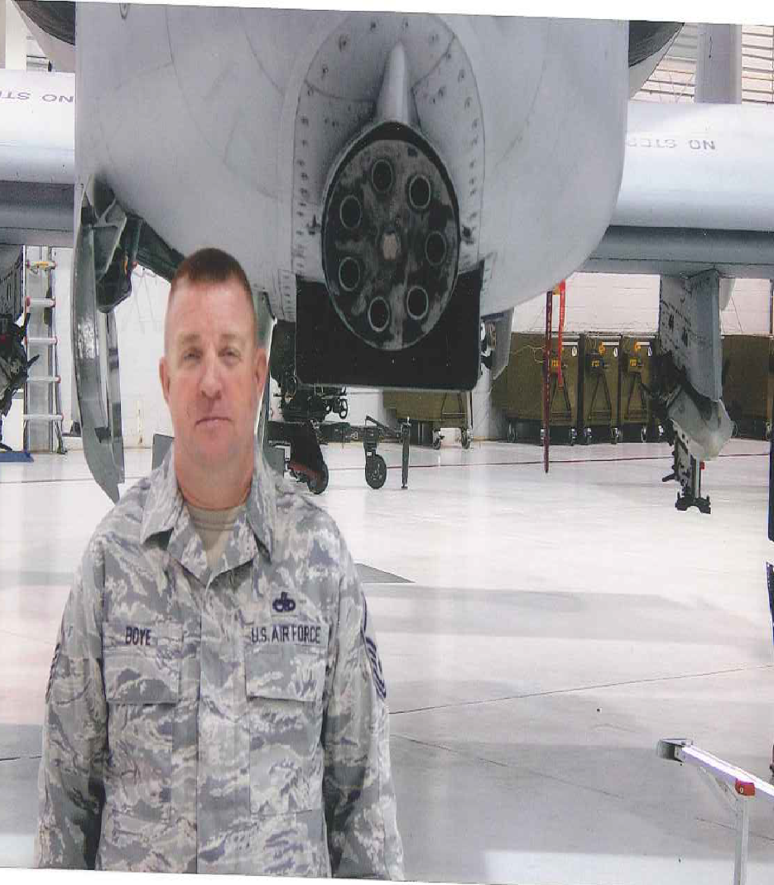
Robert Boye Air Force – MSgt (retired)
Years of service: 26 Deployments – Al-Jaber Air Base, Kuwait – 1998; Incirlik Air Base, Turkey – 2000; Bagram AFB, Afghanistan – 2002; Suda Bay Crete: 2003; Bagram AFB, Afghanistan – 2006; Kandahar Afghanistan – 2011 & 2012 and numerous others
Military service: Joined Air Force in 1988, became a crew chief on the A-10 Warthog. Traveled the world for different operations to help fight terror groups
Father of CHS student Brooke Boye

Slide 8
Ben Bronkema Army - Major
Years of service: 17
Deployments: 4 deployments to Afghanistan
Related to CHS students Karli and Micah Neal and CES student Gaige Neal

Slide 9
Shane Bryan Marine Corps, Cpl
Years of service: 4 years, 9 months
Deployments: Japan, China, South Korea
Military service: 0341 Infantry
Uncle of Nichole and Cheyenne Estes

Slide 10
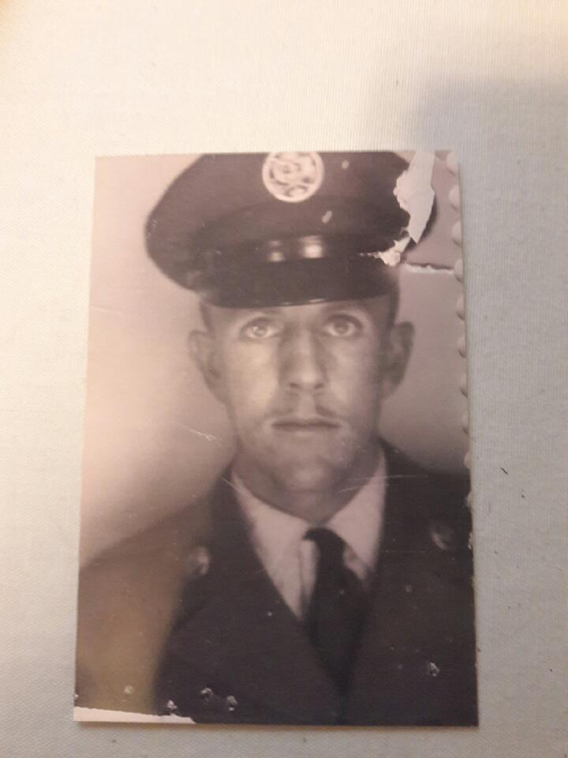
Clarence Creason
Rank: Private 3rd Class Airman
Years of Service: 8
Deployments: Korea
Military Service: In the Army from 1949-1950 where he received a service medal and a bronze star. He joined the Air Force in 1955 and then went into the reserves until 1965.
Related to CHS student Carson Haley

Slide 11
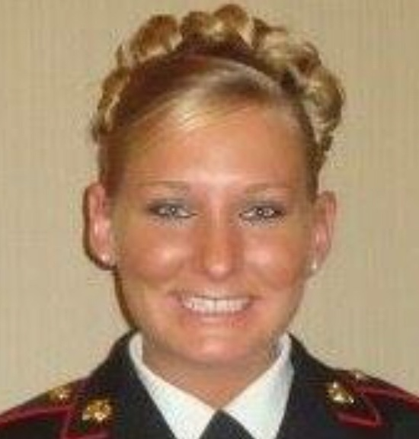
Amy Delatte Sergeant, United States Marine Corps
Years of service: 7
Deployments: Operation Iraqi Freedom, Operation Enduring Freedom
Military service: I joined the Marine Corps in August 2006 as a field radio operator. My first duty station was in Cherry Point, North Carolina where I deployed to Iraq in January 2009. My second duty station was in Camp Pendleton, California where I deployed to Afghanistan in February 2010. My last duty station was in Aurora, Colorado where I served on Inspector-Instructor duty. I was honorably discharged after 7 years and now reside in Thibodaux, Louisiana.
Aunt of Chasidy Cheney (CHS student)

Slide 12
Brady Delatte Corporal, United States Marine Corps
Years of service: 4
Deployments: Operation Iraqi Freedom, Operation Enduring Freedom
Military service: I joined the Marine Corps in January 2005 as an Aviation Communication Systems Technician. I was stationed in Cherry Point, North Carolina. I deployed to Iraq in January 2007 and again in January 2009. I was honorably discharged after 5 years and now reside in Thibodaux, Louisiana.
Uncle of Chasidy Cheney (CHS student)

Slide 13
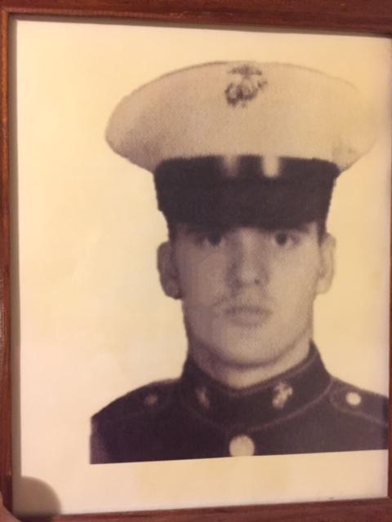
Mark A. Donahoo USMC - Corporal.
Years of service: 4
Deployments: Overseas to Okinawa & Philippines
Military service: Artilleryman and Infantry
Related to CHS student Hunter Kearney

Slide 14
James Droege
Rank: SP4
Years of Service: 2
Deployments: October 1965-March 1967 in Germany
Military Service: Served with the 4th Armored Division Band
Grandfather to CHS student Piper Droege

Slide 15
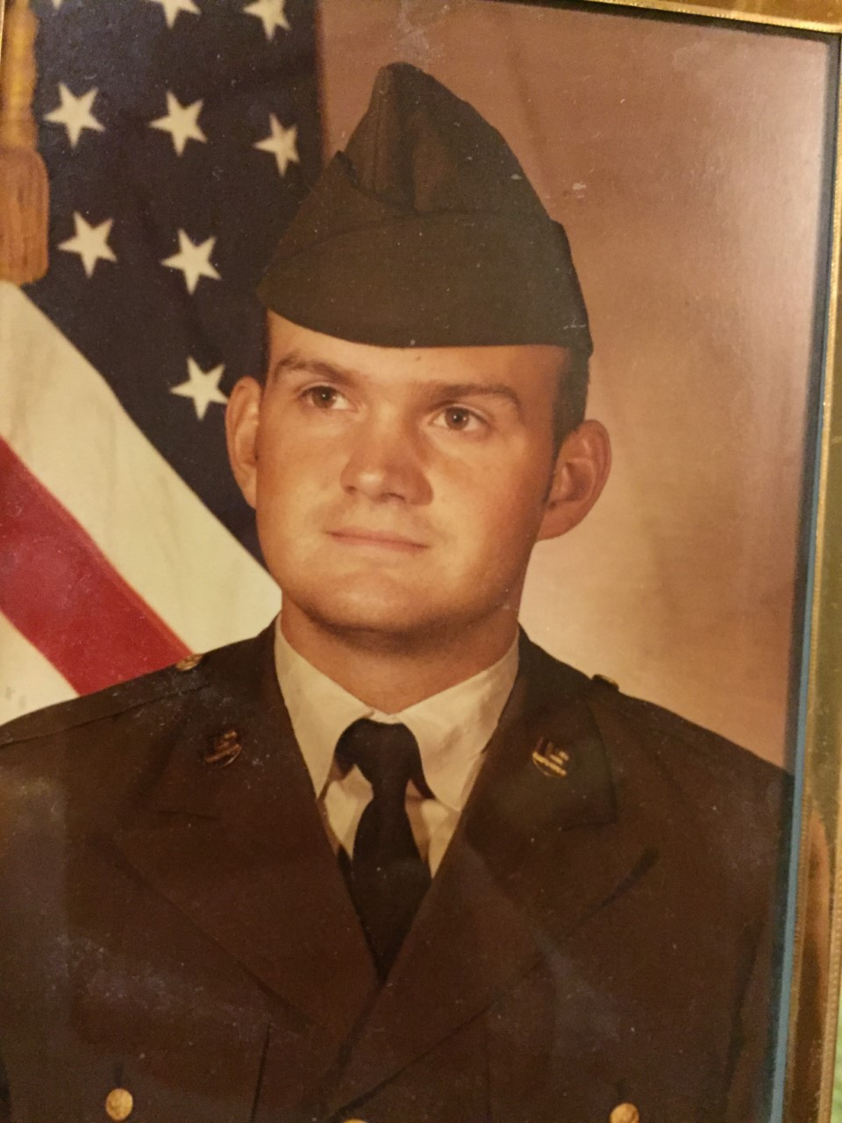
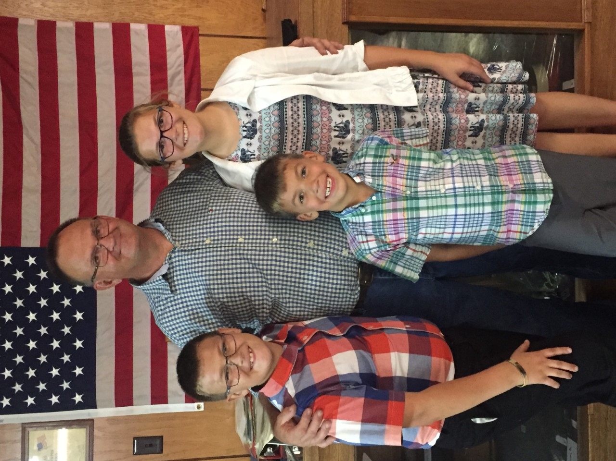
Chad Dyke Army– Staff Sergeant
Years of service– 9 ½
Deployments– Trans Americas (Panama) twice Lyons Forces (Germany, Luxembourg, Belgium)
Military service– Started out small vehicle
and generator mechanic ended as
motor pool sergeant
Grandfather to students Owen & Brayden Reid (CHS);
Father to Amanda Reid

Slide 16
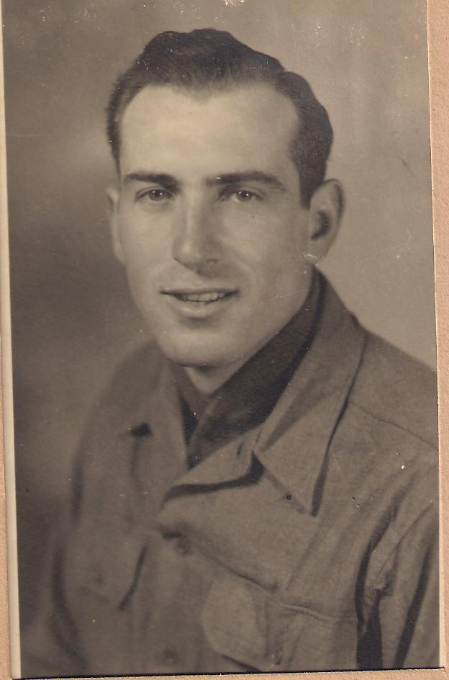
Gerald D. Ellis
Rank: E-4 Corporal Army
Years of Service: 4
Deployments: WW2 (Africa; Anzio, Italy)
Military service: Communications
Grandfather to Karen Hemme (CHS teacher)

Slide 17
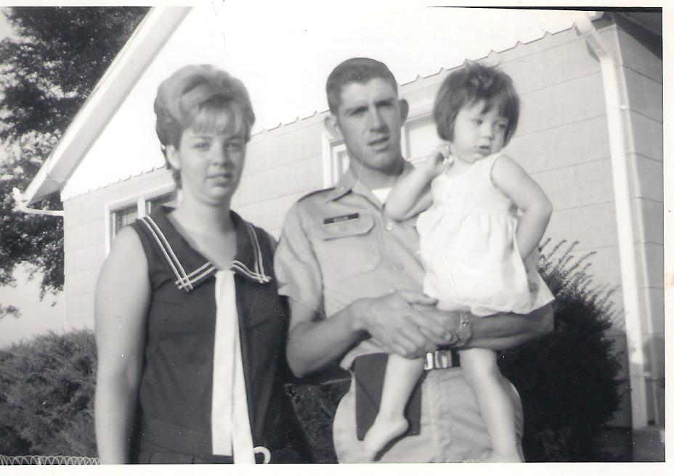
Roger D Ellis
Rank: E-7 Sgt. 1st Class in Army
Years of Service: 29 ½
Deployments: Vietnam (July 1970- July 1971)
Military service: Personnel Administration- retired March 1, 1999
Father to Karen Hemme (CHS teacher)

Slide 18
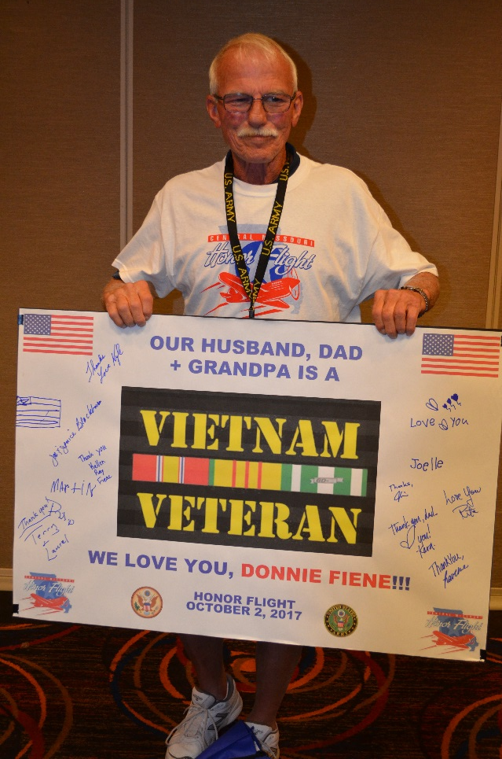
Donald R. Fiene
Rank: SP/5
Years of Service: 2
Deployments: Vietnam
Military service: Drafted into the Army 3/2/69; deployed to Vietnam 8/1/69; drove a tractor trailer at the 110th transportation company, hauled helicopter parts; left Vietnam 10/18/70
Grandfather to CHS student Kellen Fiene

Slide 19
Bret David Fleming
Rank: Special Army
Years of Service: 5
Deployments: Nov. 2007- Jan. 2009 to FOB airborne Iraq. Deployed to Afghanistan Nov. 2010 to May 2011
Military Service: Joined Army after High School in July 2006 basic training in Ft. Huachuca, Arizona for 20 weeks in interrogation school
Related to CHS students Kenzie, Tabitha, and Jeff Lynn

Slide 20
Stephanie Ann Foster Air Force – Senior Airman
Years of service: 4 ½
Deployments: Traveling for Air Force in California, Louisiana, and England
Military service: My aunt Stephanie is from (upstate) New York. Was stationed at Whiteman AFB in Missouri. Her job was offensive avionics technician on the B-2 Spirit Bomber. As an avionics technician she helped maintain the radar, navigation, and other computer systems on the jet. She participated in Operation Allied Force and Operation Enduring Freedom
Aunt of CHS student Kenzie, Tabitha, and Jeff Lynn

Slide 21
Tobias K. Foster Air Force – Sergeant
Years of service: 5
Deployments: An operation in Saudi Arabia
Military service: Tobias K. Foster grew up in Greenwood, Indiana. Joined Air Forces after college to be a Security Force Police Officer at Whiteman AFB
Related to CHS students Kenzie, Tabitha, and Jeff Lynn

Slide 22
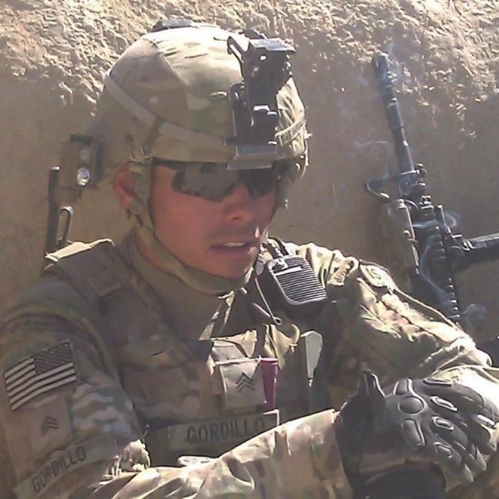
Ramon P. Gordillo Sergeant E-5
Years of service: 9
Deployments: Operation Iraqi Freedom (2009-2010), Operation Enduring Freedom (Afghanistan 2012-2013), Operation Enduring Freedom (Horn of Africa 2014-2015)
Father of Rylie & Gabriel Gordillo (CHS and CES students)

Slide 23
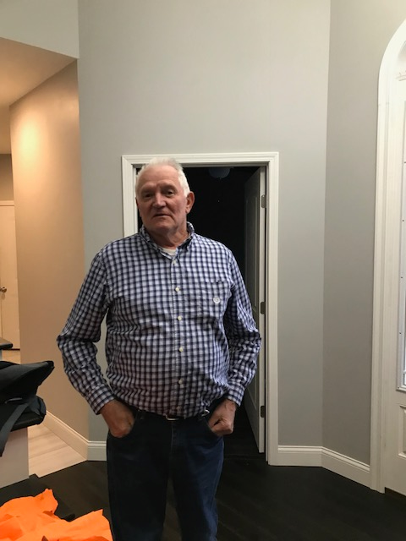
Kenny Graf Army – SP4
Years of service: 2
Deployments: Germany
Military service: Heavy truck driver, transported missiles
Grandpa of CHS students Ava and Olivia Hemme

Slide 24
Timothy Haas Army – Sgt. Bravo
Years of service: 7
Deployments: Three deployments to Afghanistan
Military service: Joined June 2008; honorably discharged Nov. 2015. Uncle Timmy was a combat engineer that would clear the route for other US soldiers to make it safely to their designation
Related to CHS student Hunter Haley

Slide 25
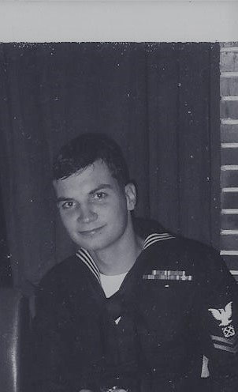
Stan Krezesinski
Rank: BM-2 (US Navy)
Years of Service: 4
Deployments: Vietnam 8/66- 8/67, Vietnam 11/67- 12/67, Mediterranean 11/68-3/69
Military service: USS Cook (APD- 130), USS Jamestown (agtr-3), River Assault Squadron 11, USS Ozark (MCS-2)
Grandpa of Kaelyn Krause (CES student)

Slide 26
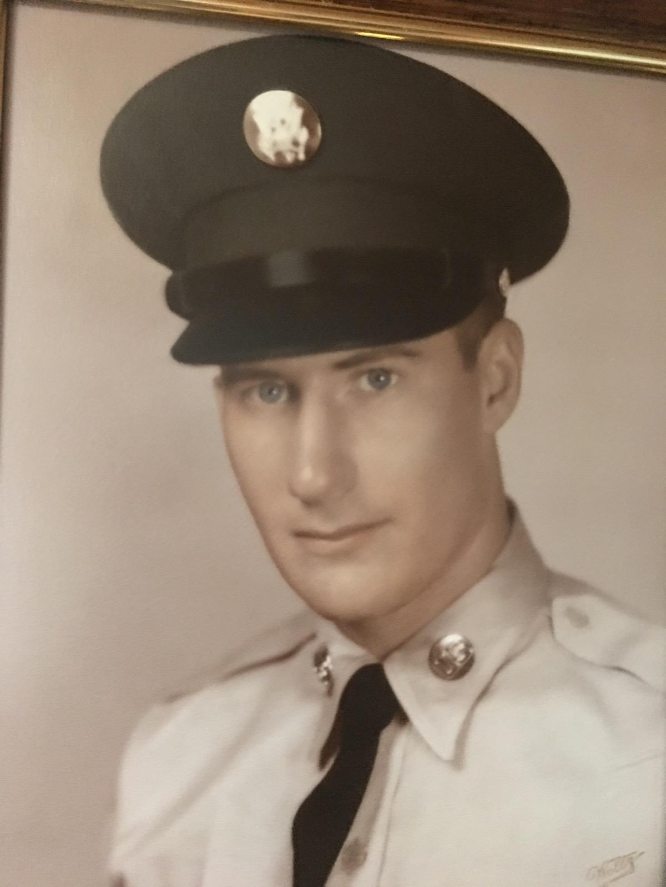
Randolph Lemmert
Rank: E-4 Specialist
Years of Service: 2 (1962-1964)
Deployments: Germany
Military Service: 78th Engineer Batallion,
Medic, Expert Marksman, Rifleman team
Father-in-law to Ms. Becca

Slide 27
Wayne Lindemann Army – Specialist Class 1
Years of service: 3
Deployments: Korea (1967- 1968)
Military service: Went to Basic Training at Ft. Leonard and received Advanced Training at Ft. Bliss
Grandpa to CHS student Dillon McGinnis

Slide 28
Jerry Glenn Mann
Rank: Specialist 5
Years of service: 2
Deployments: Vietnam
Military service: Drafted in 1966 at the age of 18, grew up in Dixon, MO. Basic training and AIT at Fort Leonard Wood, MO. His two brothers were drafted at the same time, one to Marines, other to Army. He was on a ship with more than 10,000 men.
Related to Kali Moulton (CHS student)

Slide 29
Patrick McManus Airforce (MO Air National Guard) - SMSgt
Years of service: 22
Deployments: Saudi Arabia, Turkey, Iceland, Israel, Guam
Military service: Began service in St. Louis working on the F-15 Eagles until transferred to Whiteman to work on the B-2 Stealth Bomber.
Father to CHS student Jackson McManus

Slide 30
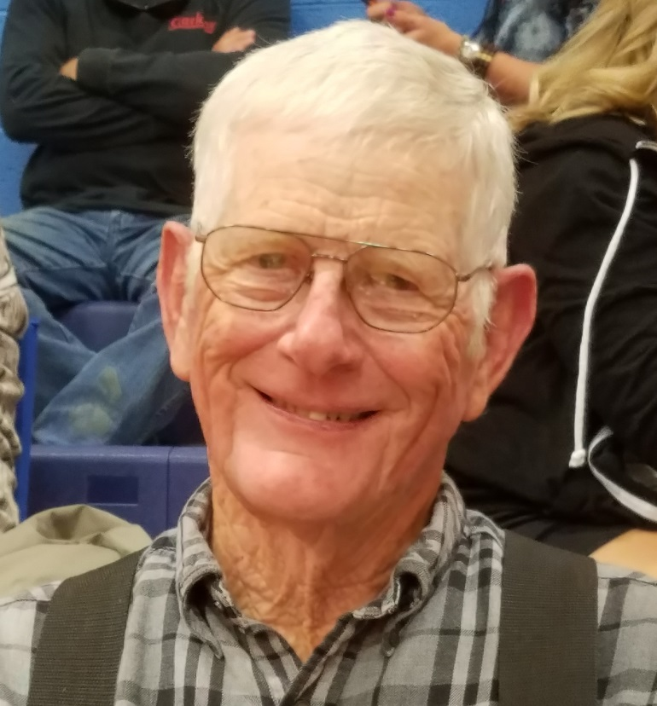
Vernon Ohrenberg Specialist 4th class
Years of service: 2
Deployments: Iraq
Military service: Headquarters company at Fort Knox, KY
Grandpa to CHS students Kellen Fiene & Gavin Ohrenberg

Slide 31
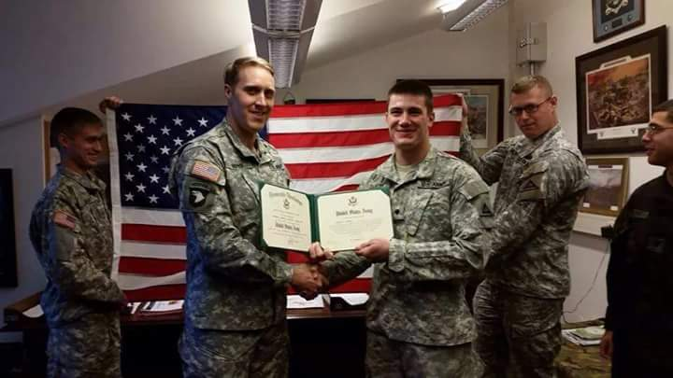
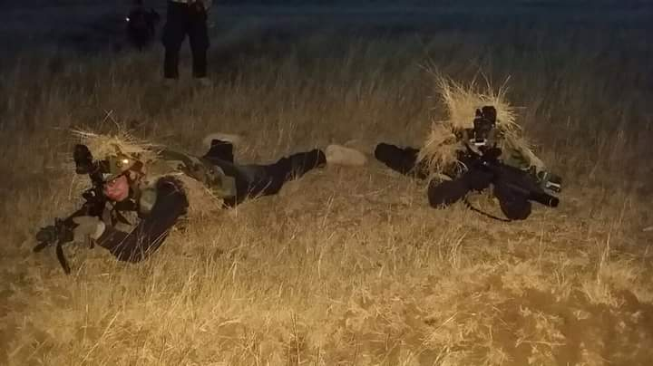
Jonathan Qureshi Army - Corporal
Years of service: 5
Deployments: Iraq
Military service: Spent his first 3 years of service in Germany. In 2016 was deployed to Iraq.
Uncle to Konner and Kollen Akau

Slide 32
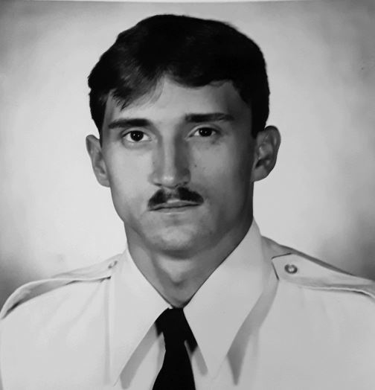
Randy Ratliff
Rank: E-5 (Staff Sergeant), US Air Force
Years of Service: 8 (1982-1990)
Deployments: multiple short deployments to Germany, Saudi Arabia, Grenada, Panama, Korea, Iceland
Military Service: U.S. Air Force, Security Police, Tactical Air Command Rapid Deployment Force
Grandfather to Gage Ratliff

Slide 33
Randy Reynolds
Rank: Senior Master Sergeant (E-8)
Years of Service: 18
Military Service: 6 years active duty U.S. Air Force, 10 years in the Air National Guard, worked on the B-1 and B-2 bombers
Husband of Courtney Reynolds, Father of Dakota, Lexi and Max

Slide 34
Homer Roepe
Rank: Corporal
Years of Service: 1943-1946
Deployments: Philippines
Military Service: Combat engineer
Great-grandfather to Brandon, Brody Roepe, Brianna Rolf, Malia Roepe (CHS and CES)

Slide 35
Kevin Roepe
Rank: Captain, USMC
Years of Service: Active duty 2010-2014; Reserve duty 2016 - present
Deployments: Border Advisory Team, Afghanistan
Military Service: Logistics officer at Camp Pendleton, reserve officer for Korean Support Team in New Orleans
Cousin to Brandon, Brody, Malia, Olivia, Brianna, and Erin (CES and CHS)

Slide 36
Ronald Roepe
Rank: Spec 4th Class Army
Years of Service: 1966-1968
Military Service: Explosive Ordnance Disposal (Bomb Squad), Ft. Benjamin, Harrison, IN
Great-Uncle to Brandon, Brody & Malia Roepe, Brianna Rolf, Erin Heimsoth (CHS and CES)

Slide 37
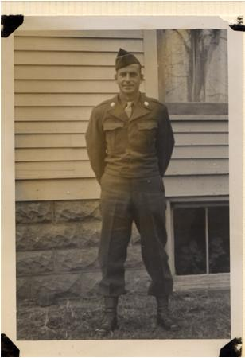
Robert G Sartin
Rank: Private in the Army
Years of Service: 1
Deployments: He was deployed to Korea but had to return home to work on the farm
Military service: Mechanic
Grandfather to Karen Hemme (CHS teacher)

Slide 38
Bonny Smith Army – Private First Class
Years of service: 3
Deployments: New Guinea during WWII.
Military service: Served in New Guinea as a warehouseman. He kept track of supplies and preparing them to be shipped or taken to soldiers on the front lines. Received the American Theater Ribbon, Asiatic Pacific Theatre Ribbon with one bronze star, Victory Medal, Good Conduct Medal, and three Overseas Bars.
Great-Grandfather to Gavin Ohrenberg

Slide 39
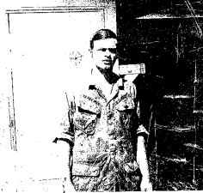
Michael Trautman
Rank: Petty Officer 2nd class (E-5), Naval Security Group
Years of Service: 1969-1973
Deployments: San Miguel, Republic of Philippines, 1972-73; DaNang, Republic of Vietnam, 1971-72
Military Service: Navy Achievement Medal, Combat Action Ribbon, Vietnam Campaign medal and Service medal
Instructor (and former principal) here at CHS!

Slide 40
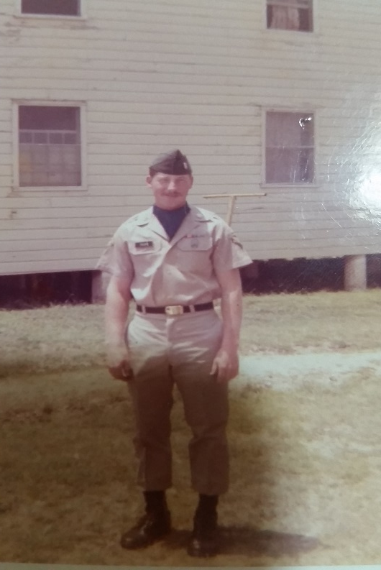
Jim Tyler
Rank: Specialist 5th Class
Years of Service: 3
Deployments: South Korea for 13 months (Sep. 1970-Oct. 1971)
Military Service: Enlisted under Army delayed program. He was sent to Korea as a helicopter radio mechanic in Sep. 1970
Grandfather to CHS and CES students Taylor and Tyler Gard

Slide 41
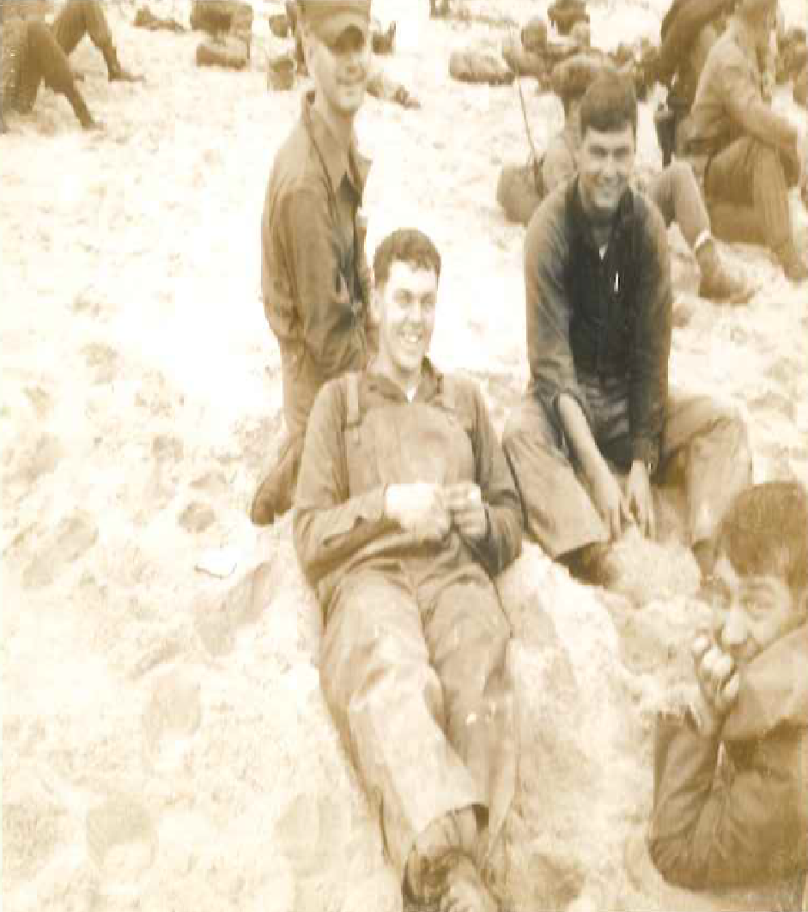
Robert A West
Rank: Corporal USMC
Years of service: 18 months
Deployments: Cue Viet South Vietnam
Military service: Patrolled Cue Viet river as a driver of an amphibious tractor while looking for NVA soldiers
Grandpa of Holly and Aaron Brown (CHS)

Slide 42
Donny Fitzpatrick
Rank: Staff Sergeant
Years of Service: 9
Deployments: 4 deployments for a total of 2 years
Worked in special mission security for convoys
Related to CHS and CES students Cash Fitzpatrick, Kinlee Riley, and Keaghan Fitzpatrick

Slide 43
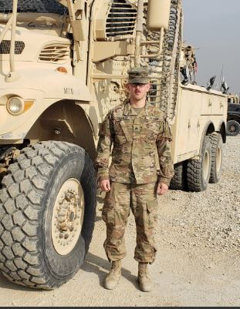
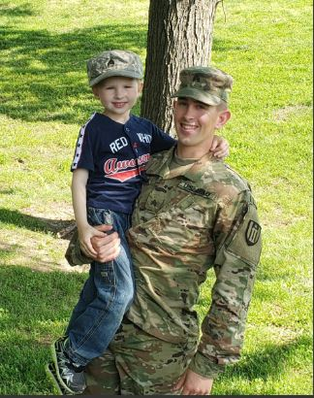
James Sherman
Rank: Sergeant in Army
Years of Service: 2014 - present
Military Service: He is part of the 348th Engineering Company out of Kansas City; was deployed to Afghanistan
Uncle of CES student Wyatt Sherman & cousin of Janice Gudde

Slide 44
Dennis Payne
Rank: SSG
Years of Service: 20
Deployments: Operations Armored Falcon & Iraqi Freedom
USMC from 1990-1996; USMC Reserves from 1997-1998; MO Army National Guard from 2002-2015
Related to students Thadius (CES) and Kynleigh Abney (CHS)

Slide 45
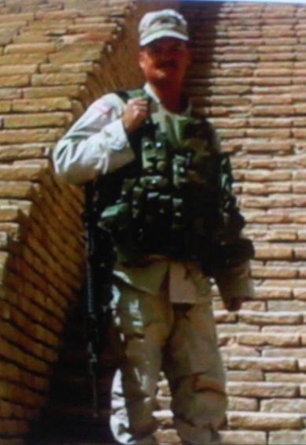
Scott Wallace
Rank: Sergeant First Class
Years of Service: 22
Deployments: South Korea, Wakenda, Operations Nobel Eagle, Enduring Freedom, Iraqi Freedom
Military Service: MO National Guard, combat engineer
Father of CES instructor Megan Butler

Slide 46
George Cook
Rank: Sergeant
Years of Service: 6
Deployments: Afghanistan
United State Marine Corps
Duty Station: Camp Lejeune and Okinawa
Uncle to CES student McKenna Cook

Slide 47
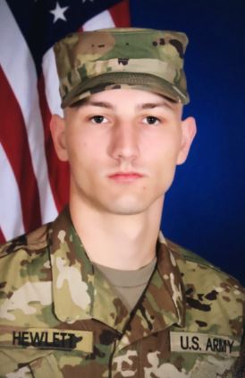
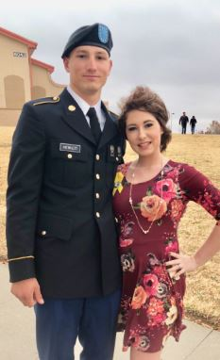
Garrett Hewlett
Rank: E-2
Years of service: 2018 - present
Military service: completed basic training at Fort Sill, OK; then AIT at Fort Lee, VA
Brother to CES instructor Megan Butler

Slide 48
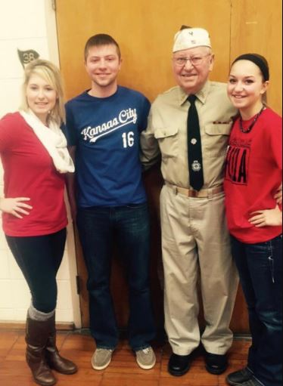
Karl Wenzel
Years of Service: 1954-1956
Deployments: Stationed in France, served in Korean War
Military Service: served in the motor pool and managed the officer’s club
Grandfather of CES instructor Megan Butler

Slide 49
David Wray
Rank: MSGT
Years of service: 20
Deployments: Thailand (twice), Germany, Africa
Military service: Service superintendent, Service police
Related to Caleb & Katie King; Virginia, Anna, & Kayllie Dempsey; and Liam King (CES and CHS students)

Slide 50
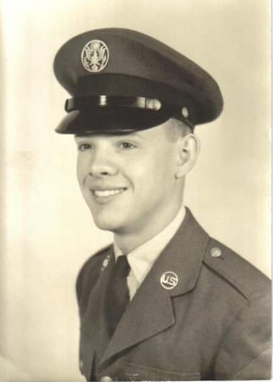
Larry Hardison
Rank: Sergeant
Years of Service: 1963-1967
Deployments: Vietnam, 1966-1967
Military service: Lackland AFB, San Antonio, TX; Lowry AFB, Denver, CO (trained for Intelligence Operation Specialist); Richards Gebaur AFB, Belton, MO; Saigon, Vietnam (Covert Intelligence Operations)
Grandparent of CHS student Aneira Jones

Slide 51
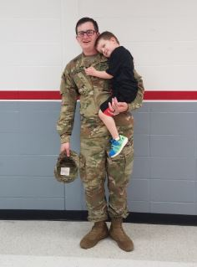
Cole Borgstadt
Rank: Specialist
Years of Service: 7
Deployments: Kuwait, 2018-2019
Military service: Missouri National Guard; UH-60 Blackhawk Mechanic
Family of CES student Michael Babler

Slide 52
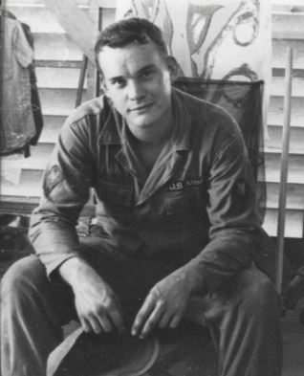
Jerry Steinkuhler
Rank: Specialist E-5
Years of Service: 1965-1967
Deployments: Qui Nhon, Vietnam
Military service: Drafted in 1965 into the Army; stationed at Fort Leonard Wood, MO and Fort Benning , GA; member of the 98th Ordinance (Light Equipment) Company
Grandfather of CHS student Colton Steinkuhler

Slide 53
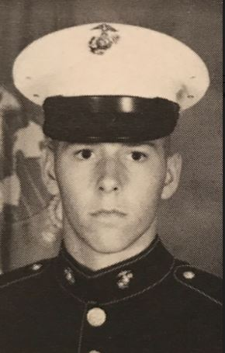
David Williams
Rank: Sergeant – US Marine Corps
8 Years of Service
Deployments: Operation Desert Storm/Desert Shield
Military service: Stationed at Camp Pendleton, Ocean Side, CA; was reservist when activated back to active duty for deployments
Family of CHS student Nevaeh Glasgow

Slide 54
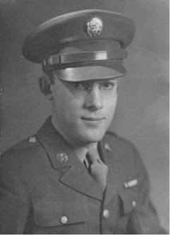
Lloyd Beissenherz
Rank: Master Sergeant, US Army
Years of Service: 1941-1945, World War II
Deployments: Normandy, Northern France, Germany
Military service: Investigator for the Counter Intelligence Corps; BAR Marksman & Pistol Marksman; awarded 3 Bronze Stars & Good Conduct Medal, among others
Great-Grandfather of CHS students Faith Moore & Eli Beissenherz, & Eden Beissenherz (CES)

Slide 55
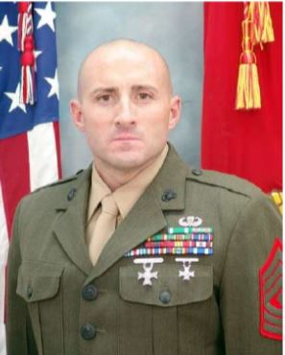
Robert W. Ashby, Jr.
Rank: First Sergeant
20 Years of Service
Deployments: Uzbekistan, Afghanistan, Japan
Military service: Aviation Radar Tech, MC Communication Electronic School Chief Instructor, Maintenance Chief, Inspector-Instructor First Sergeant
Uncle of CHS student Dillon McGinnis

Slide 56
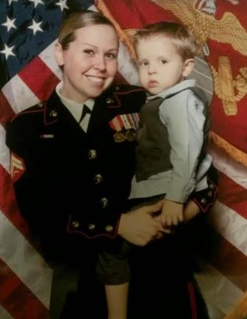
Chelsea Frerking
Rank: Sergeant
5 years of Service
Deployments: Operation Enduring Freedom in Afghanistan
Military service: Served as Field Radio Operator, deployed with Navy Medical Unit when in Afghanistan
Mother of CHS student Bentlee Reed

Slide 57
Dan & Lori Pragman
Rank: Dan – Spc; Lori – PFC
8 years of service for Dan; 1 for Lori
Military service: Dan served 4 years in active duty with the Army & 4 years with the Army Reserve; Lori served with the Missouri Army National Guard
Grandparents of CES students Alacia & Illyonna Smith

Slide 58
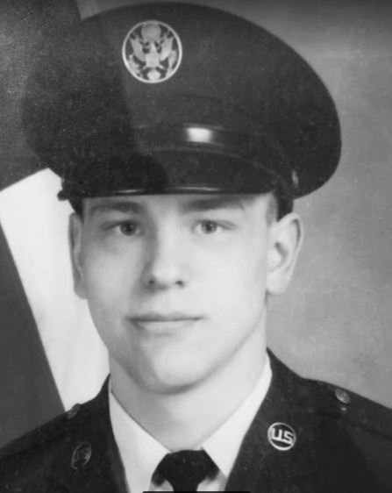
Dan Gilio
Rank: SSgt/E-5
10 years of Service
Military service: Stationed at Whiteman Air Force Base as Security Police; Served during the Cold War and Desert Shield/Storm; worked on the Rail Garrison Project
Grandfather of CES student Danni Oberdorfer

Slide 59
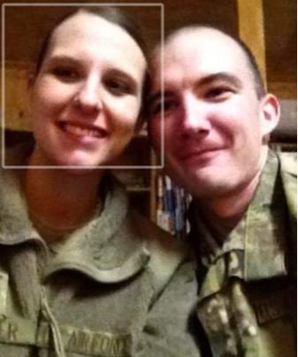
Ian Oberdorfer
Rank: E-4/SrA
8 years of Service
Deployments: Afghanistan, Saudi Arabia
Military service: Worked on the A-10 aircraft; stationed in Arizona, Germany, and California
Father of CHS student Gabbryela Oberdorfer

Slide 60
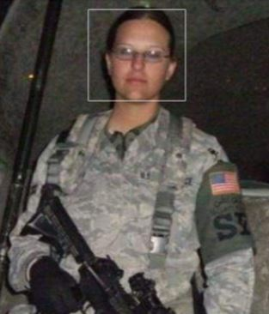
Kasidy Oberdorfer
Rank: E-5/SSgt
9 years of Service
Deployments: Afghanistan, Qatar
Military service: Worked as Security Forces and Airman Dormitory Leader; stationed in Arizona and Germany
Mother of CHS student Anja Oberdorfer

Slide 61
Roy Summers
Years of Service: 1944-45
Deployments: Japan
Military service: Machinist Mate on a minesweeper in the Sea of Japan in WWII in the US Navy
Great-grandfather of CES student Raegan Summers

Slide 62
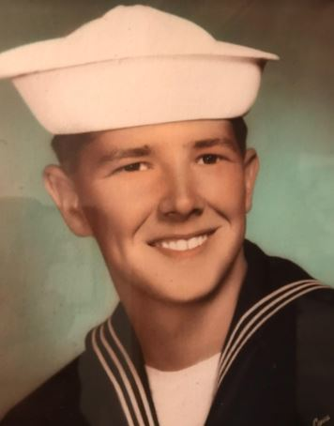
Roy Eckhoff
Rank: Petty Officer, 2nd Class
9 years of service
Deployments: 3 Mediterranean Sea Cruises, 1 Pacific Ocean Cruise, Vietnam West-Pac Cruise
Military service: Electronic Technician, worked on navigation and weapons systems, stationed in Florida and California, taught Electronic Theory
Grandfather of CES student Tilly Eckhoff

Slide 63
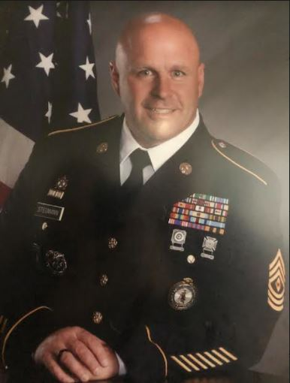
Matthew Stegmann
Rank: 1SG/First Sergeant
24 years of Service
Deployments: Afghanistan (4 years), Iraq (1 year)
Military service: 13 years of active duty & 11 years in MO Army National Guard; worked as instructor/trainer, recruiter, mobilization training NCO; company first Sergeant
Father of CHS students Alex and Abbie Stegmann

Slide 64
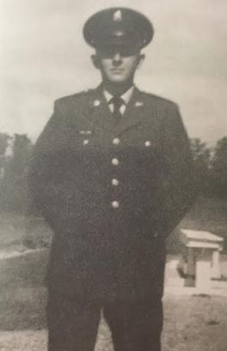
Sophus Collins
Rank: Specialist E4
2 years of service
Deployments: Vietnam
Military service: Combat Engineer
Great-Uncle of Gage Kueck

Slide 65
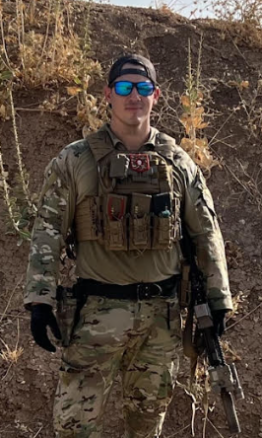
Larry Hicks, Jr.
Rank: Gunnery Sergeant
14 years of service in Marine Corps
Deployments: 3 overseas
Military service: USMC Special Forces Explosive Ordnance Disposal Chief; has had 5 duty stations; currently in NC
Uncle of CES student Athena Calvert

Slide 66
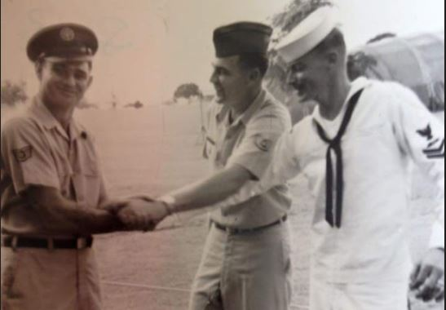
Charles Tharp
In the photo, Left to Right: Robert Tharp (uncle) Army, Charles Tharp (dad) USAF, and Jim Tharp (uncle) Navy while in Vietnam
Rank: MSGT
20 years of service in Air Force
Deployments: 3 overseas (Vietnam, Spain, Germany)
Military service: worked in TMO (stationed in California & North Dakota)
Relative of CES student, Arraeya Utterback

Slide 67
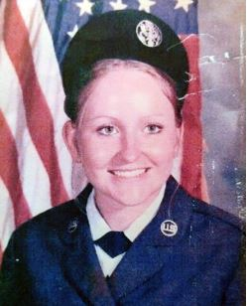
Anita McCurdy
Rank: E-5 Staff Sgt
13 years of service (1979-1992)
Deployments: 1 overseas
Military service: Space Command, Peterson AFB, Colorado (1983-1987); Strategic Air Command, Comisco, Sicily (1987); Whiteman AFB, Missouri (1981-1983 &1987-1992)
Grandma of CES student Malia Roepe

Slide 68
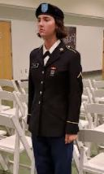
Destiny Flint
Rank: E-3
2.5 years of service (currently serving)
Military service: Enlisted in 2019 and again in 2021; currently serving in the Missouri Army National Guard
Sister to Izabella Caldwell and Cassidy Caldwell

Slide 69
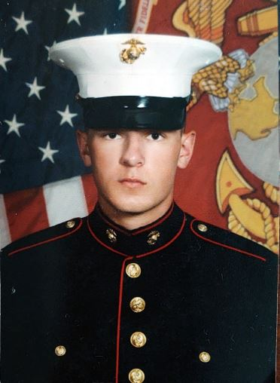
Justin L. Williams
Rank: Corporal
4 years of service
Deployments: 2020 USS Bataan Amphibious; 7 months to Europe, Middle East, and Africa
Military service: Military motor transport operator; served as security team leader and logistics planner
Uncle to students Zell, Avery, and Zirah Hinck

Slide 70
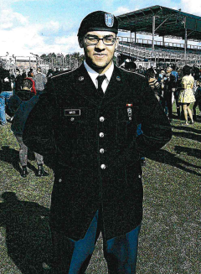
Christopher Mays
Rank: E-5
3 years of service
Deployments: Kabul, Afghanistan
Military service: Stationed at Ft. Bragg in North Carolina; in the 82nd Airborne division & serves on the Instant Response Force
Son of CHS admin assistant Debra Johnson, and brother to CHS students Dominick and Isabella Johnson

Slide 71
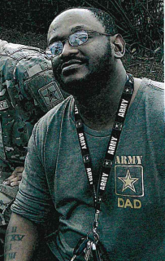
Wilbert (EJ) Johnson
Rank: E-4
6 years of service
Deployments: Taji, Baghdad, Fallujah, Najahaf in Iraq
Military service: Stationed at Ft. Benning and Ft. Hood; Infantry soldier; served 3 tours in Iraq diving Bradley tank
Husband to CHS admin assistant Debra Johnson, father to CHS students Dominick & Isabella Johnson

Slide 72
Steve Denton
Rank: 2LT
Years of service: 2019 - present
Military service: 91B (Wheeled Vehicle Mechanic), 35th ID HSC, Lexington, MO; OCS (Officer Candidate School), Ft. Leonard Wood, MO; 276th Engineer Co., Pierce City, MO
CHS Physical Education Instructor and head Track & Field Coach

Slide 73
Juan Rosas-Arritola
Rank: Staff Sergeant
9 years of service
Deployments: Afghanistan, Kuwait, Jordan, & United Arab Emirates
Military service: Structural engineer in the US Air Force; stationed in Guam, California, S. Korea and Whiteman AFB
Cousin to CES students Brantley & Brooklyn Shearer

Slide 74
Kevin Miller
Rank: SFC (Retired)
21 years of service
Deployments: Iraq, Korea, Germany, Bosnia
Military service: served in many capacities in many countries - Infantryman, Gunner, Safety Officer; earned many medals
Grandpa of CES student Finn Walkenshaw

Slide 75
Zane Westfall
Rank: 1 Lt.
8 years of service
Military service: Military Police Officer and commissioned as an Artillery Officer; commanded a platoon on the Paladin & then the HIMARS system
Father to CES students Kaidyn & Macy Westfall

Slide 76
John DePee
Rank: E-5
3 years of service
Deployments: Vietnam (1970-1971), Japan (1970)
Military service: Worked on Army helicopters & aircraft; specialized in prop & tail rotors
Grandfather of CES student Joseph Morrison

Slide 77
John Edward Estes
Rank: Sergeant
4 years of service
Deployments: Vietnam, Japan
Military service: Stationed in Okinawa, Japan - when the plane stopped to refuel, he was picked to go to Vietnam
Grandfather of CHS student Avriella Estes

Slide 78
Monroe Kirchhoff
Rank: Sgt
Deployments: Germany
Military service: Drafted into World War II in Germany
Great-grandfather of CHS student Ben Kirchhoff and CES student Luella Kirchhoff

Slide 79
Steven Anderson
Rank: Colonel, USAF
29 years of service
Deployments: Operations Northern Watch, Southern Watch, Iraqi Freedom, Enduring Freedom
Military service: Commander of the 688th Cyberspace Wing, TX (final duty before retiring) after many other assignments
Great Uncle to CES student Bennett Werths

Slide 80
Kenton Mueller
Rank: Staff Sergeant, USAF
5 years of service, 1972-1977
Deployments: Germany
Military service: He joined the Air Force after attending college. He was honorably discharged on May 16, 1977
Grandfather to CES & CHS students Ayla and Ashton Wilt

Slide 81
Jacob Borgstadt
Rank: SFC
17 years of service
Deployments: OEF (2013-2014) Afghanistan; OIR (2018-2019) Iraq
Military service: Worked at various bases on Apache & Blackhawk helicopter repairs; currently serving as Platoon Sergeant with Rco 1-135th Assault Helicopter Battalion
Father to CHS/CES students Hallie & Lincoln Borgstadt

Slide 82
Blake Meineka
Rank: Sergeant
9 years of service
Deployments: 2021-22 deployed to Arizona/Mexico border
Military service: Training at Fort Leonard Wood & Fort Lee, currently a diesel mechanic with the KS Army Nat’l Guard
Uncle to CES students Brantley & Brooklyn Shearer and Mason Howard

Slide 83
Wilmer Ziegelbein
Rank: Corporal
Military service: Drafted into the US Army in 1952. Trained at Fort Leonard Wood and was stationed there until he left the service in 1954.
Grandfather of CES student Wyatt Sherman

Slide 84
William Crowell
Rank: Sgt
Years of service: 10
Deployments: 2 years deployed during Operation Iraqi Freedom and 1 year deployed during Operation New Dawn
Father to CES student Alyssa Cook

Slide 85
Richard Fricke
Rank: SP4 E-4
Years of service: 1969-1975
Deployments: Vietnam
Military service: Served in Vietnam, then returned to Fort Riley, KS. Served with B Co. Bn 10th 1st Infantry Div; recipient of many medals (Nat’l Defense Service Medal, Air Medal, etc.)
Grandpa to CES teacher Hannah Bargfrede

